Slide 1


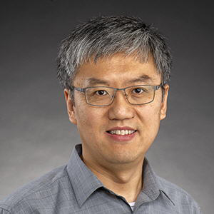
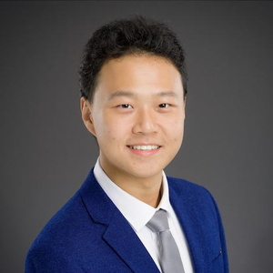
NoSQL Databases for Bioinformatics
GraphDB basics
Information
Services
St. Jude Children’s Research Hospital
High Performance Computing Support
Yawei Hui
Ziang Zhang
Data Bases and Data Wrangling Series. Lecture#26
Notes:
Greeting. Introduce the lecturers and the HPC Support team. Read the title: the second lecture of day two is about graph databases. In the afternoon (Lecture 27) we build a genome graph; this morning we learn the concepts and the Cypher language with a small example: this very course. The workbook is 3-graphdb-concept/workbook.ipynb.

Slide 2

Learning Objectives
At the end of the session, you will be able to:
Understand the fundamental data model
• Nodes
• Relationships
• Properties
Understand graph traversal techniques
Understand genomic data as a graph
Notes:
Three objectives: understand the fundamental data model (nodes, relationships, properties); understand graph traversal techniques; understand genomic data as a graph. The last objective is covered by the bridge slide near the end and by the afternoon workshop.

Slide 3
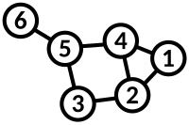
What is a graph?
Graph is a mathematical structures used to model pairwise relations between objects
https://en.wikipedia.org/wiki/Graph_theory

Slide 4
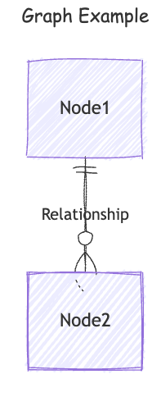
Graph Components
Node (Vertex)
  The main data element from which graphs are constructed
Relationship (Edge)
  A link between two nodes. Has
    Direction
    Type

Slide 5
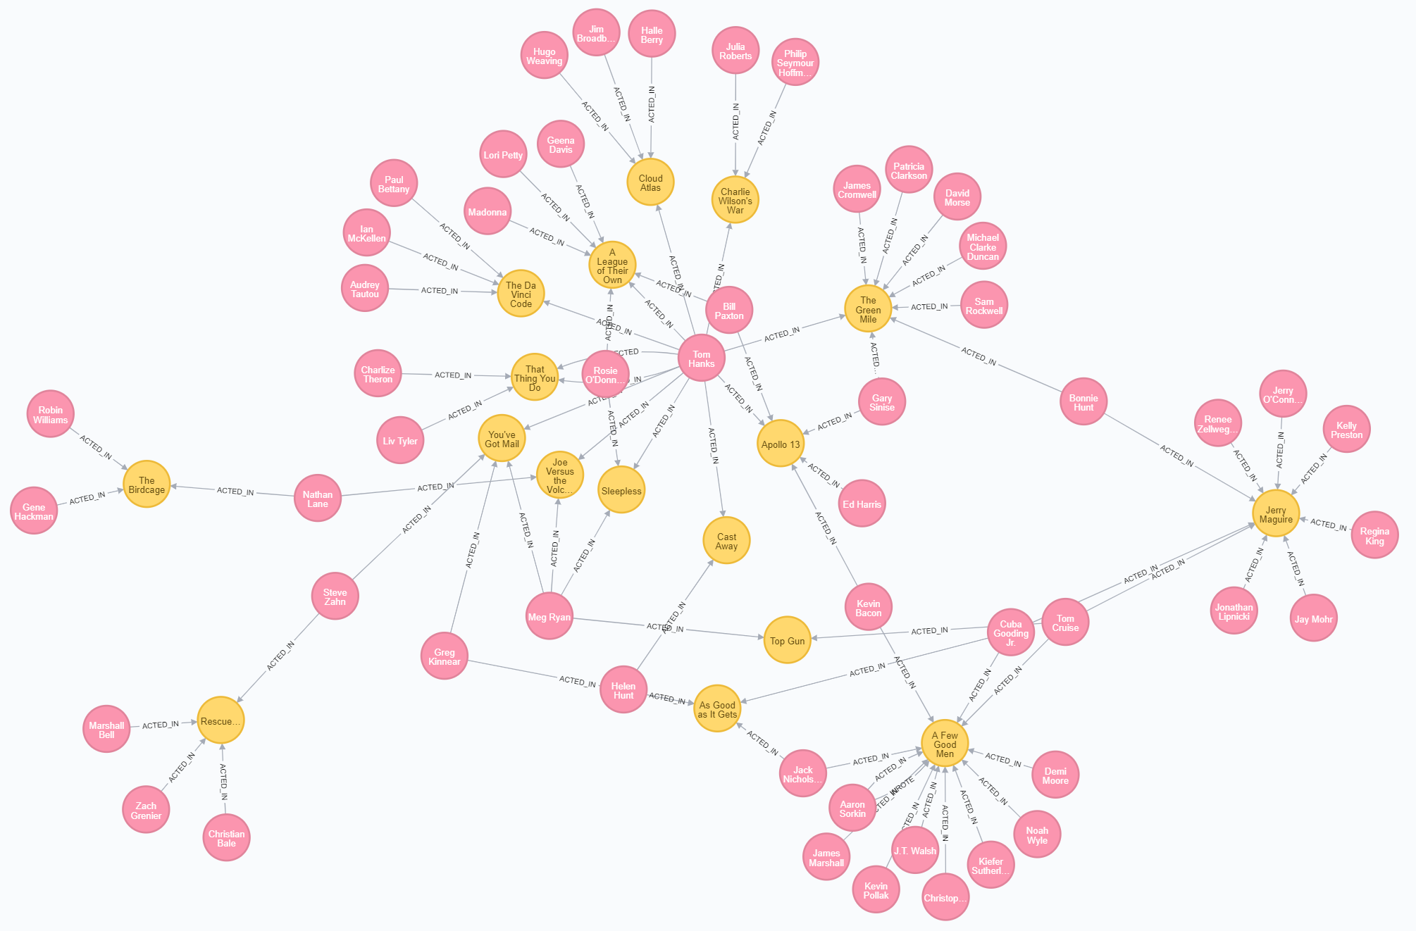
Example Graph - Movie

Slide 6
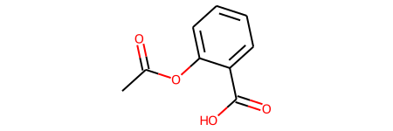
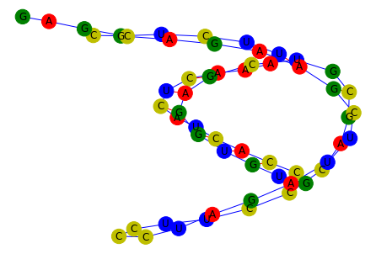
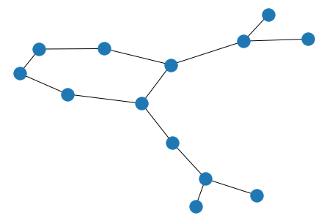
Example: Molecular and RNA Graph
CC(=O)OC1=CC=CC=C1C(=O)O
Notes:
https://graphein.ai/notebooks/protein_graph_analytics.html

Slide 7
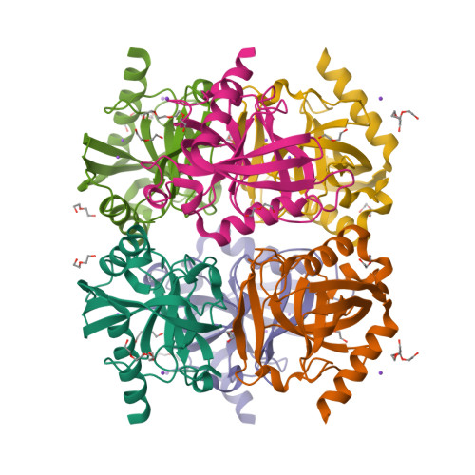
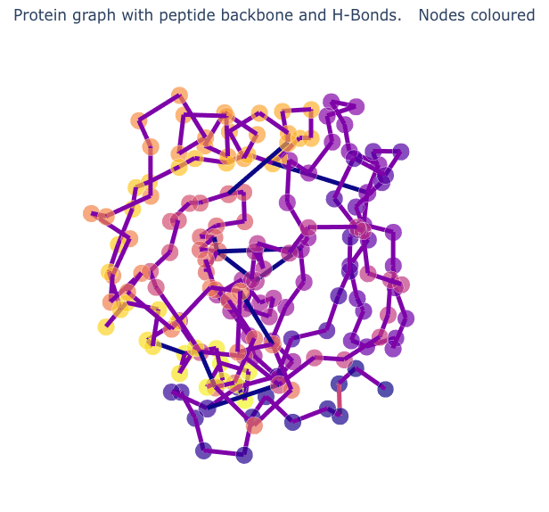
Example: Protein Graph Analytics
Notes:
https://graphein.ai/notebooks/protein_graph_analytics.html

Slide 8
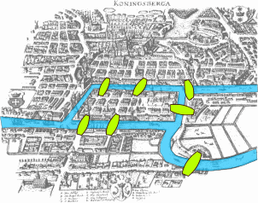
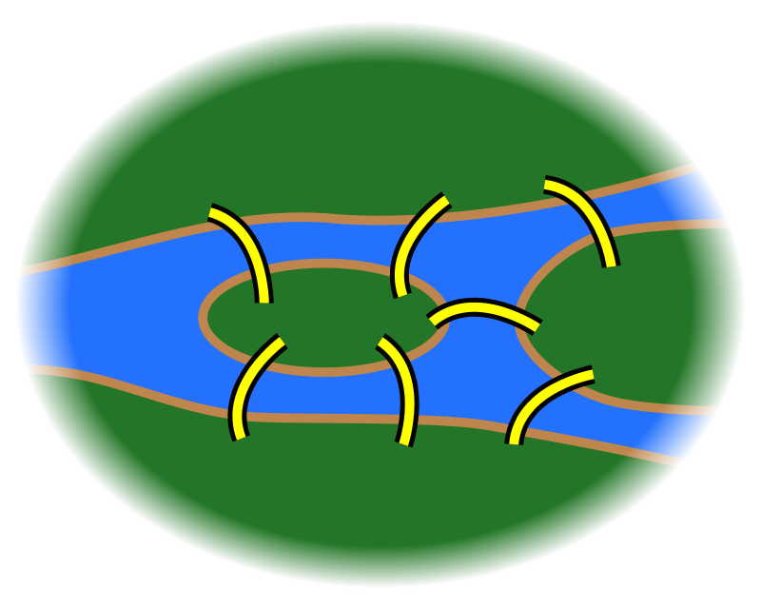
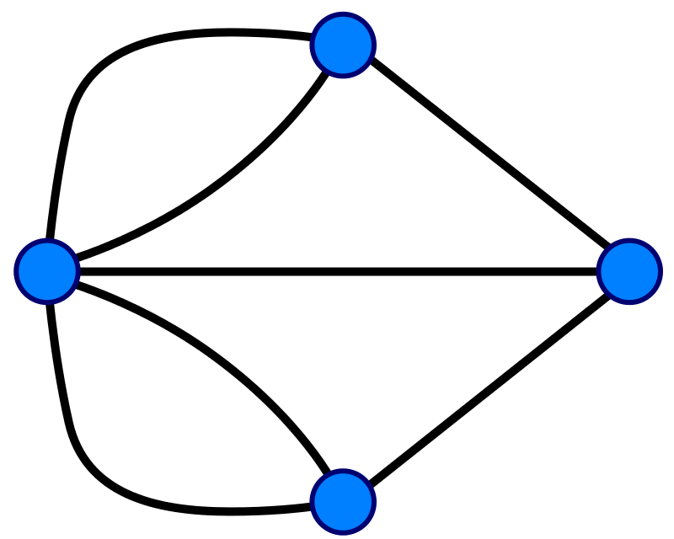
A graph is…
A set of discrete entities, each of which has some set of relationships with the other entities
Seven Bridges of Konigsberg problem. Leonhard Euler, 1735

Slide 9
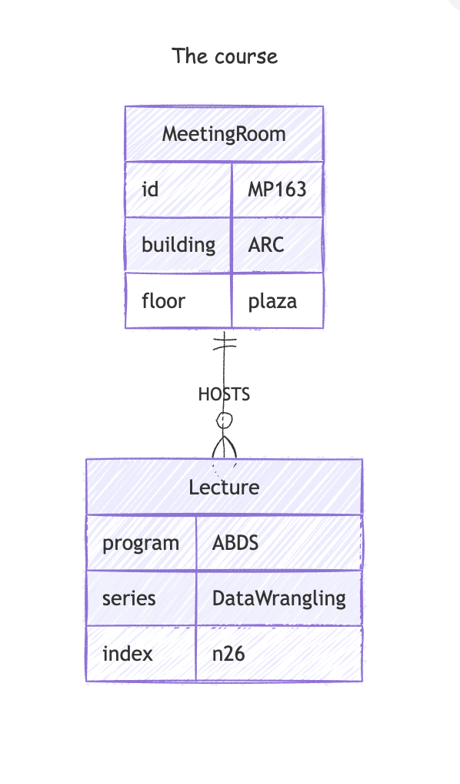
Graph Database
Node (Vertex)
  Label(s): A node can zero, one, or more labels.
  Property: Key-value pairs that describes the node.
  MATCH (n:Lecture {program: "ABDS"})
  RETURN n
Edge (Relation)
  Type: An edge must have ONE type
  Property: Key-value pairs that describes the edge.
  MATCH ()-[r:HOSTS]-()
  RETURN r
Traversals
  The query combines relations and nodes
  MATCH (m:MeetingRoom)-[:HOSTS]->(l:Lecture {series: "DataWrangling"})
  RETURN m.id, m.floor
{
startTime: '20251022 9:00:00',
endTime: '20251022 10:30:00'
}
Notes:
---
title: The course
---
erDiagram
MeetingRoom {
id MP163
building ARC
floor plaza
}
Lecture {
program ABDS
series DataWrangling
index n26
}
MeetingRoom ||--o{ Lecture: HOSTS

Slide 10
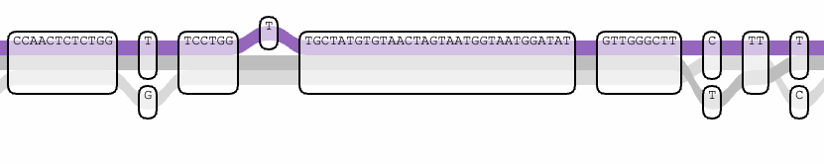
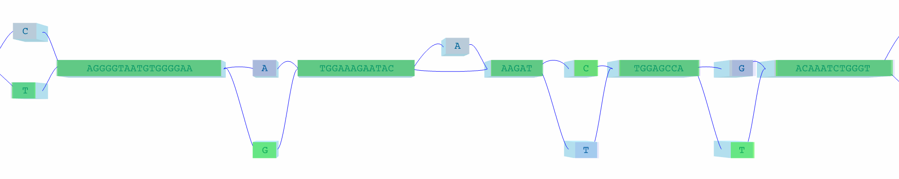
Example: pangenome visualization with pgv
A pangenome represents genetic variation in a population as a variation graph
Notes:
https://github.com/w-gao/pgv
Is this a good example that could be stored into the graph DB?

Slide 11
Hands-on: your own Neo4j, on your laptop
HANDS-ON
1
Start
2
Look
3
Code
cd docker
docker compose up -d
docker compose ps → healthy
Neo4j Browser
http://localhost:7474
user neo4j · password workshop_neo4j
jupyter lab
open 3-graphdb-concept/
then workbook.ipynb
Python
(neo4j driver)
Bolt :7687
Neo4j server
(Docker)
HTTP :7474
Neo4j Browser
(web UI)
NoSQL Databases for Bioinformatics · Lecture 26 · Graph database basics
‹#›
Notes:
The remote Neo4j Aura / Hetionet instance used in the first version of this lecture is no longer needed: every student runs a Neo4j database in a Docker container on their own laptop. docker compose up -d in the docker/ folder starts it (together with MongoDB). The Neo4j Browser at http://localhost:7474 is a web UI where you can type Cypher and see the graph; Python reaches the same database through the neo4j driver on the Bolt port 7687. The workbook for this lecture is 3-graphdb-concept/workbook.ipynb and it uses both the Python driver and an interactive graph viewer.
User neo4j, password workshop_neo4j. These are workshop-only credentials: the port is bound to 127.0.0.1, so only your own laptop can connect.
If anything does not work: python scripts/check_setup.py tells you what is wrong, and SETUP.md has a troubleshooting table.

Slide 12
Cypher: ASCII art for graphs
HANDS-ON
(r:MeetingRoom {id: 'MP163'}) -[:HOSTS]-> (l:Lecture {index: 'n26'})
pattern | meaning
() | any node
(n) | any node, called n
(:Lecture) | a node with label Lecture
(l:Lecture {index: 'n26'}) | a Lecture whose property index is 'n26'
--> or -[]-> | a relationship, any type, pointing right
-[:HOSTS]-> | a relationship of type HOSTS
-[r:HOSTS {since: 2021}]-> | …named r, with a property
-- | a relationship in either direction
( ) = circle on the whiteboard
: = “is a”
{ } = properties
-> = direction
NoSQL Databases for Bioinformatics · Lecture 26 · Graph database basics
‹#›
Notes:
Cypher is a declarative pattern-matching language: you draw the shape you are looking for and Neo4j finds every place where that shape occurs. Round brackets are nodes (the circles on the whiteboard) and arrows are relationships. Inside the brackets, the name before the colon is a variable you choose so that you can refer to the node later, the word after the colon is the label, and curly braces hold properties. A relationship has square brackets with its type, and a direction.
Example: (r:MeetingRoom {id: 'MP163'})-[:HOSTS]->(l:Lecture {index: 'n26'}) reads 'room MP163 hosts lecture n26'. A double dash -- matches a relationship in either direction.
The official reference card is at dev.neo4j.com/refcard.

Slide 13
CREATE vs MERGE
HANDS-ON
CREATE: always creates
MERGE: get-or-create
CREATE (:MeetingRoom {id: 'MP163'})
CREATE (:MeetingRoom {id: 'MP163'}) // twice!
MATCH (m:MeetingRoom) RETURN m.id
MERGE (:MeetingRoom {id: 'MP163'})
MERGE (:MeetingRoom {id: 'MP163'}) // safe
MATCH (m:MeetingRoom) RETURN m.id
2
nodes with the same id: duplicates
1
node: idempotent, safe to re-run
Rule of thumb: MERGE to load data, CREATE only when you are sure it is new. Put only the identifying properties in the MERGE { } braces and use SET for the rest.
NoSQL Databases for Bioinformatics · Lecture 26 · Graph database basics
‹#›
Notes:
CREATE always makes a new node: run it twice and you get two nodes. In the workbook we do exactly that with the room MP163 and look at the two internal ids to prove it: one real room, two nodes. Real data must not contain such duplicates.
MERGE first looks for the pattern and creates it only if it is missing: get-or-create. Running a MERGE script repeatedly changes nothing, a property called idempotence, which makes scripts safe to re-run. Rule of thumb: use MERGE for loading data, CREATE only when you are sure the thing is new. Put only the identifying properties inside the MERGE braces and set the other properties with SET.
In the workbook, the course-graph script is run twice: the first run creates 7 nodes and 12 relationships; the second run creates nothing new.

Slide 14
Build the course graph
HANDS-ON
MERGE (room:MeetingRoom {id: 'MP163'})
SET room.name = 'MP163',
room.building = 'ARC'
MERGE (zz:Lecturer {uid: 'zziang'})
SET zz.name = 'Ziang Zhang'
MERGE (l26:Lecture {series: 'DataWrangling',
index: 'n26'})
SET l26.name = 'n26 GraphDB basics',
l26.startTime = '2025-10-22T09:00'
MERGE (room)-[:HOSTS]->(l26)
MERGE (zz)-[:GIVES]->(l26)
// … the same for n24, n25, n27
// and the second lecturer
MeetingRoom
MP163
HOSTS
Lecture
n24 n25 n26 n27
7 nodes (1 room, 2 lecturers, 4 lectures)
12 relationships (4 HOSTS + 8 GIVES)
GIVES
Lecturer
zziang · yhui
NoSQL Databases for Bioinformatics · Lecture 26 · Graph database basics
‹#›
Notes:
We model this very course. The room MP163 in the ARC building hosts four lectures of the DataWrangling series (n24 to n27), and the two lecturers give all four. Nodes: MeetingRoom, Lecturer and Lecture. Relationships: HOSTS from room to lecture, GIVES from lecturer to lecture.
The script on the right creates everything with MERGE: 7 nodes and 12 relationships on the first run. The times are stored as ISO-8601 text, which sorts correctly and is easy to draw; a Neo4j datetime() would also work but cannot be drawn by the viewer we use. Every node type also gets a name property which the viewer uses as a caption; the identifier of each type (id, uid, index) is used for look-ups.
Then in the workbook we draw the graph with the interactive viewer: hover or click a node to see its properties.

Slide 15
Exercise: check in to the course
HANDS-ON
1 · Create your node
2 · Connect it
A Student node with your own uid.
An ATTENDS relationship from you to lecture n26, with a property (e.g. checked_in).
Solution (try first!)
MERGE (s:Student {uid: 'your_name'}) SET s.name = 'your_name'
MATCH (s:Student {uid: 'your_name'}),
(l:Lecture {series: 'DataWrangling', index: 'n26'})
MERGE (s)-[a:ATTENDS]->(l)
ON CREATE SET a.checked_in = toString(datetime()) // only when new
NoSQL Databases for Bioinformatics · Lecture 26 · Graph database basics
‹#›
Notes:
The exercise from the lecture slides: add yourself to the graph. First create a Student node with your own uid, then connect it to the lecture n26 with an ATTENDS relationship. Give the relationship a property, for example checked_in, to prove that relationships can have properties too.
Solution: MATCH both existing nodes (the comma means both patterns must be found), MERGE the relationship and SET its property. ON CREATE SET sets the property only when the relationship is new; toString(datetime()) stores the current time as text. Because of MERGE, running the solution twice does not create a second ATTENDS relationship.
In the workbook three classmates (alice, bob, carol) are added so that the next slides have something to traverse.

Slide 16
Read: MATCH, WHERE, RETURN and aggregation
HANDS-ON
Filter by property
Filter with WHERE
MATCH (l:Lecture {index: 'n26'})
RETURN l.title
MATCH (l:Lecture)
WHERE l.startTime >= '2025-10-22'
AND l.title CONTAINS 'workshop'
RETURN l.index, l.title
→ GraphDB basics
→ n27 · Neo4j genome workshop
Two hops
Aggregate (no GROUP BY)
MATCH (m:MeetingRoom {id: 'MP163'})
-[:HOSTS]->(l:Lecture)
<-[:GIVES]-(p:Lecturer)
RETURN DISTINCT p.name
MATCH (p:Lecturer)-[:GIVES]->(l:Lecture)
RETURN p.name,
count(l) AS n_lectures,
collect(l.index) AS lectures
→ Ziang Zhang · Yawei Hui
→ each lecturer: 4 · [n24 n25 n26 n27]
NoSQL Databases for Bioinformatics · Lecture 26 · Graph database basics
‹#›
Notes:
Reading data means describing the shape you are looking for with MATCH, optionally filtering with WHERE, and choosing what to give back with RETURN. A property map inside the pattern, {index: 'n26'}, and a WHERE clause are two ways to filter. WHERE can express any condition: comparisons, AND/OR/NOT, CONTAINS, STARTS WITH, IN [...].
A traversal follows relationships: 'which room hosts which lectures?' draws the pattern (m:MeetingRoom)-[:HOSTS]->(l:Lecture). Two hops: (m:MeetingRoom)-[:HOSTS]->(l:Lecture)<-[:GIVES]-(p:Lecturer) walks backwards from the lecture to the lecturer; the arrow direction is how the data is stored, but you can match from either end.
Aggregation without GROUP BY: as soon as you use count or collect, every non-aggregated column in RETURN becomes the grouping key. Returning whole nodes and relationships gives a graph picture; returning properties gives a table.

Slide 17
Traversal: classmates = shared neighbours
HANDS-ON
alice
MATCH (me:Student {uid: $uid})
-[:ATTENDS]->(l:Lecture)
<-[:ATTENDS]-(classmate:Student)
WHERE classmate <> me
RETURN classmate.uid,
count(l) AS shared_lectures,
collect(l.index) AS which
n24
me
n26
n27
classmate | shared_lectures | which
carol | 2 | [n27, n26]
alice | 1 | [n26]
carol
ATTENDS → shared lectures: carol 2, alice 1
🔑 Remember: person → shared thing ← person finds similar entities
NoSQL Databases for Bioinformatics · Lecture 26 · Graph database basics
‹#›
Notes:
A graph database shines when a question needs several hops. 'Which students shared at least one lecture with me, and how many?' is a two-hop traversal: from me to a lecture I attend, and from that lecture to another student who attends it too. The pattern is (me:Student)-[:ATTENDS]->(l:Lecture)<-[:ATTENDS]-(classmate:Student), with WHERE classmate <> me to exclude myself.
In the workbook's example data, 'student_demo' attends n26 and n27, carol attends n24, n26 and n27, alice attends n24, n25 and n26. So carol shares two lectures with me (n26 and n27) and alice shares one (n26).
REMEMBER THIS PATTERN: person -> shared thing <- person. It finds 'similar' entities by the things they have in common. In the next lecture the students become genomes and the lectures become gene functions (KOs). Variable-length paths: add a star to repeat a relationship, for example (:Lecture)-[*1..2]-(x) is everything within two steps of a lecture.

Slide 18
Update and delete
HANDS-ON
task | Cypher
change / add a property | SET n.prop = value
several at once | SET n += {a: 1, b: 2}
remove a property | REMOVE n.prop
add a label | SET n:Visitor
delete a relationship | MATCH ()-[r:ATTENDS]->() DELETE r
delete a node and its relationships | DETACH DELETE n
MATCH (s:Student {uid: 'bob'}) DELETE s
// ✗ Cannot delete node, because it still has relationships
MATCH (s:Student {uid: 'bob'}) DETACH DELETE s // ✓
Safety net
Plain DELETE refuses to leave dangling relationships. DETACH DELETE is the explicit “yes, remove everything”.
NoSQL Databases for Bioinformatics · Lecture 26 · Graph database basics
‹#›
Notes:
SET adds or changes properties, including several at once with +=, and it can add a label (SET s:Visitor adds a second label to the same node: a node can have several labels). REMOVE deletes a property; DELETE deletes a relationship or a node.
Plain DELETE of a node fails while the node still has relationships. Neo4j will not leave dangling relationships behind: in the workbook the error is 'Cannot delete node, because it still has relationships. To delete this node, you must first delete its relationships.' DETACH DELETE removes the relationships first and then the node. MATCH (n) DETACH DELETE n wipes the whole database, so use it with care; the workbook uses it at the beginning and at the end to start from a clean slate.

Slide 19
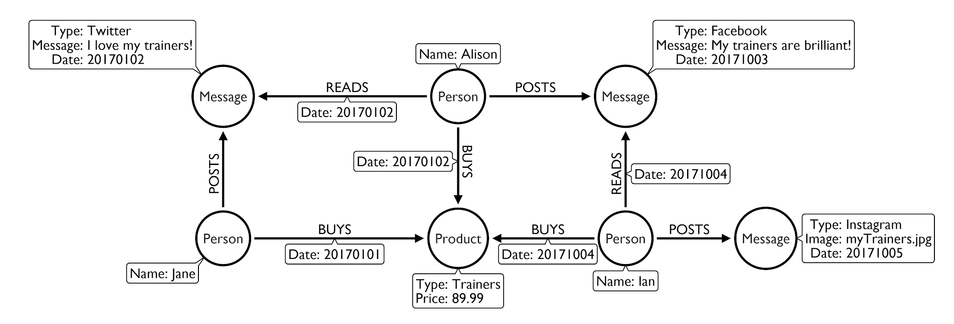
Who can use graph? – Retail

Slide 20
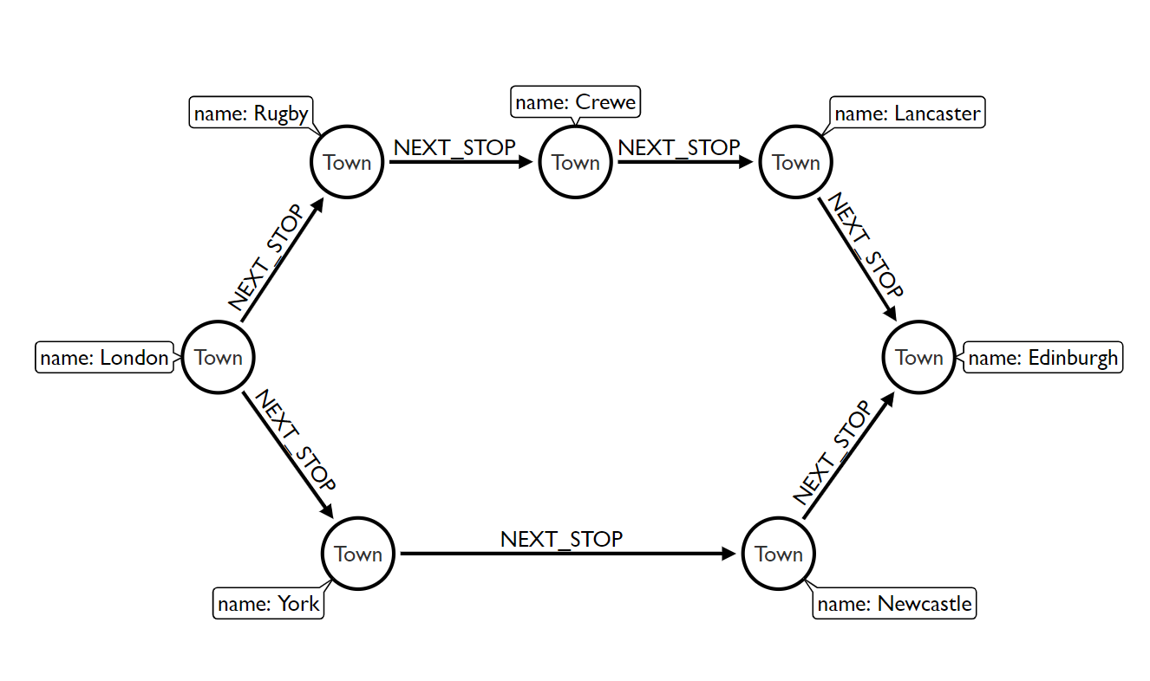
Who can use graph? – Public Transportation

Slide 21
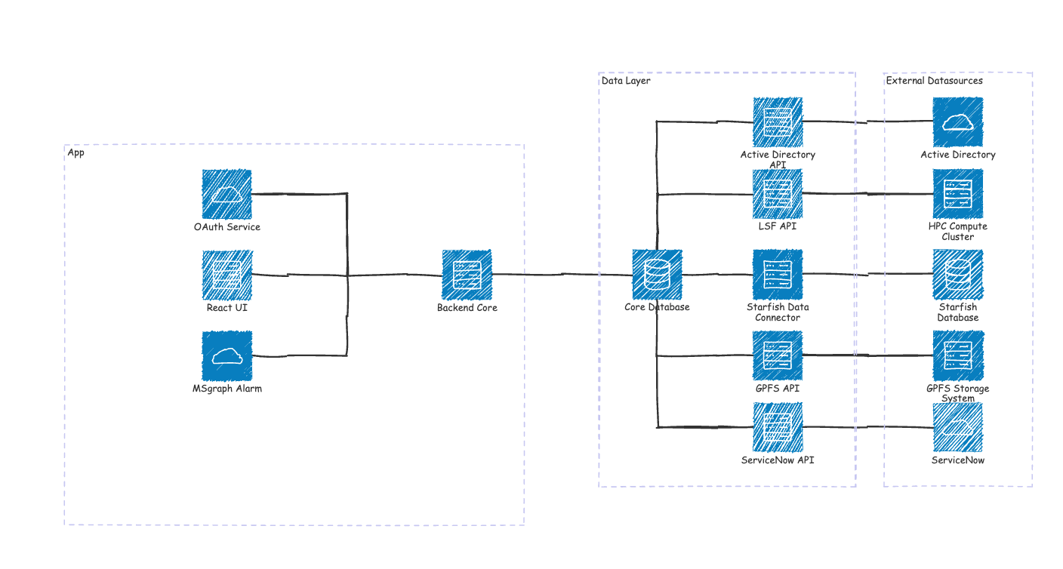
Who can use graph? – Engineer

Slide 22
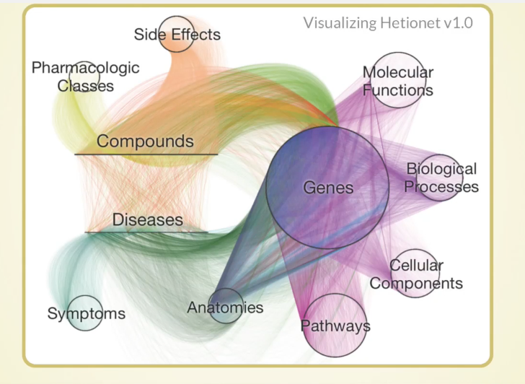
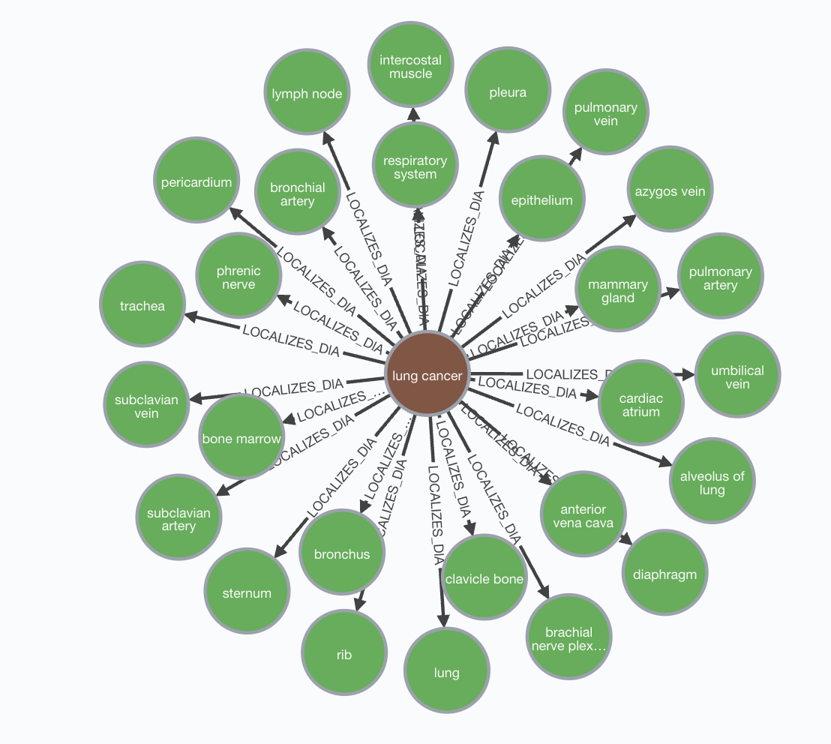
Where can graph be used? -- BioScience

Slide 23
From classmates to genomes
BRIDGE
Course graph | Genome graph (Lecture 27)
(:Student) | (:Genome)
(:Lecture) | (:KO): a gene function (e.g. K04077 = chaperonin GroEL)
-[:ATTENDS]-> | -[:CONTAINS_KO]->
classmates: students who share lectures | similar genomes: genomes that share KOs
a lecture belongs to a series | a taxon is a child of a taxon: the tree of life
Synechocystis
psbA
Similar to E. coli?
genome | shared KOs
B. subtilis | 2 (groEL, fliC)
Synechocystis | 1 (groEL)
E. coli
groEL
B. subtilis
fliC
Same two-hop pattern, new data: Lecture 27
NoSQL Databases for Bioinformatics · Lecture 26 · Graph database basics
‹#›
Notes:
The course graph has exactly the same shape as genomic data. Students are genomes, lectures are KOs, the ATTENDS relationship is CONTAINS_KO, and classmates (students who share lectures) are similar genomes (genomes that share KOs). A KO is a KEGG Orthology group: a gene function, for example K04077 is the chaperonin GroEL.
The tiny genome graph in the workbook has 3 genomes and 4 functions, all real KEGG Orthology IDs. Running the same two-hop pattern from E. coli: B. subtilis shares 2 KOs (groEL and fliC), Synechocystis shares 1 (groEL). B. subtilis is a fellow bacterium with flagella, so it is closer than the photosynthetic Synechocystis.
The hierarchy (a lecture belongs to a series) corresponds to the tree of life: (:Taxon)-[:CHILD_OF]->(:Taxon). In Lecture 27 we scale the same pattern to 65 genomes and almost 9,000 functions and add the tree.

Slide 24
Recap and what comes next
Concept | Remember
Node | an entity; 0+ labels, properties
Relationship | directed, exactly one type, may have properties
Pattern | (a:Label {prop: x})-[:TYPE]->(b): draw what you look for
CREATE vs MERGE | always create vs get-or-create: use MERGE for loading data
Traversal | follow relationships; shared-neighbour patterns find similar things
Aggregation | count, collect: non-aggregated columns are the grouping key
Next (Lecture 27): the same patterns on 65 genomes, 9,000 KOs and the tree of life
NoSQL Databases for Bioinformatics · Lecture 26 · Graph database basics
‹#›
Notes:
Concepts to remember. Node: an entity with zero or more labels and properties. Relationship: directed, exactly one type, may have properties. Pattern: draw what you look for. MATCH/WHERE/RETURN to read; CREATE versus MERGE (use MERGE for loading data); SET/REMOVE/DELETE/DETACH DELETE. Traversal: follow relationships; shared-neighbour patterns find similar things. Aggregation: count and collect, and the non-aggregated columns are the grouping key.
Practice questions from the workbook. 1. What is the difference between a label and a relationship type? A node can have several labels, a relationship has exactly one type, a direction, and connects two nodes. 2. Why does the classmates pattern return each pair twice, and how do you keep one? The pattern is symmetric; compare an ordering property, WHERE a.uid < b.uid. 3. Where would you store the check-in time? On the ATTENDS relationship, because it describes the pair.
Optional reading: Hetionet (neo4j.het.io) is a knowledge graph of genes, diseases, drugs and tissues; it needs internet access and is not used in the workbooks.

